Slide 1

Mental Health Status Classification
Social Media Text Analysis using Natural Language Processing
Project Authors
Abhi P Vijay & Nakshathra V

Slide 2


Introduction & Context
Our Vision
The Motivation
We aim to leverage the "digital fingerprints" left on social media to build an automated, reliable classification system that can detect depressive symptoms from raw text data, enabling early intervention.
Mental health is a critical global concern, yet many suffer in silence due to social stigma. Today, social media platforms like X (formerly Twitter) serve as a mirror to individual psychological states.

Slide 3

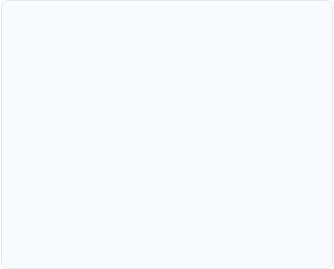
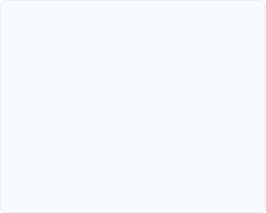



Core Project Objectives
Analysis
Automation
Accessibility
Analyze linguistic markers and emotional patterns in high-volume social media datasets.
Build a machine learning pipeline using TF-IDF and Linear Support Vector Machines.
Deploy a user-friendly interface via Streamlit for real-time mental health status prediction.

Slide 4
Problem Statement
Diagnostic Lag: Traditional mental health assessment is reactive and often happens only when a crisis occurs.
Data Underutilization: Massive amounts of behavioral text data on social media remain untapped for health screening.
System Goal: Need for a scalable, non-intrusive tool to categorize text into "Normal" or "Depression" status.

Slide 5



Tools & Technologies
Language
NLP
Deployment
Python 3.x with Scikit-learn for model training and evaluation.
NLTK (Natural Language Toolkit) for advanced text preprocessing.
Streamlit for web interface development and GitHub for version control.

Slide 6

Dataset Description
Parameter | Details
Total Records | ~50,000 Text Entries
Original Labels | 1 (Positive) / 0 (Negative)
Processed Labels | Normal / Depression
Source | Aggregated Social Media Text

Slide 7
Methodology Overview
Data Loading
Preprocessing
Vectorization
ML Training
App Launch
Importing CSV data and initial cleaning.
Text normalization and filtering.
Applying TF-IDF calculations.
Model selection and validation.
Deployment via Streamlit.

Slide 8

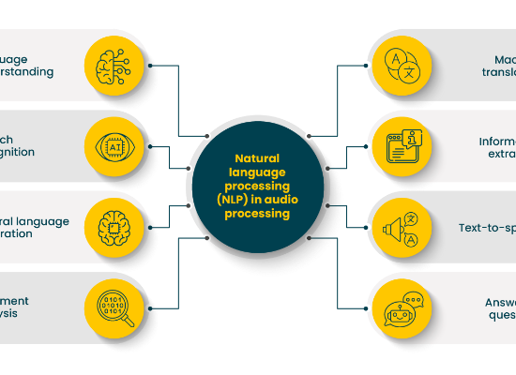
NLTK Preprocessing Pipeline
Lowercasing: Standardizing text cases.
Tokenization: Segmenting text into words.
Stopword Removal: Removing high-frequency noise.
Lemmatization: Converting words to root forms.

Slide 9


Exploratory Data Analysis (EDA)
Class Distribution
Word Frequency
The dataset maintains a healthy balance between "Normal" and "Depression" categories, ensuring the model avoids bias toward a majority class.
Analysis reveals high prevalence of self-referential pronouns and specific emotional keywords in the Depression category compared to Normal text.

Slide 10


Feature Engineering: TF-IDF
Numerical Text Representation
We transform raw text into numerical vectors using Term Frequency-Inverse Document Frequency.

Slide 11
Machine Learning Models Used
Linear SVC
Logistic Regression
Linear Support Vector Classification is optimized for large text samples, effectively finding the optimal hyperplane between classes.
A statistical model used for binary classification to estimate probabilities of text belonging to a specific health status.

Slide 12

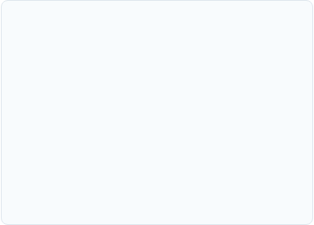
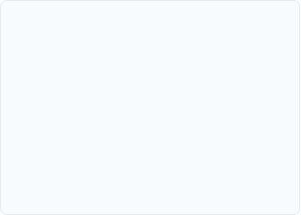



Model Evaluation Metrics
Accuracy
Precision
Recall
Overall percentage of correct classifications.
Reliability of "Depression" predictions.
Ability to find all true "Depression" cases.

Slide 13
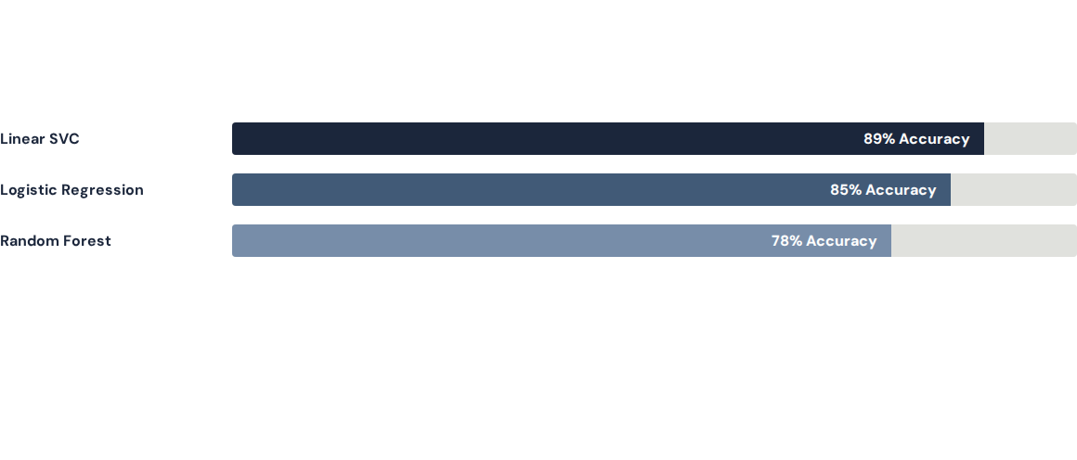
Results: Comparative Analysis
Linear SVC demonstrated superior performance in handling sparse high-dimensional text data.

Slide 14
The Winning Architecture
89%
Why Linear SVC?
High Computational Efficiency.
Effective in high-dimensional spaces.
Classification Accuracy
Clear margin of separation.

Slide 15
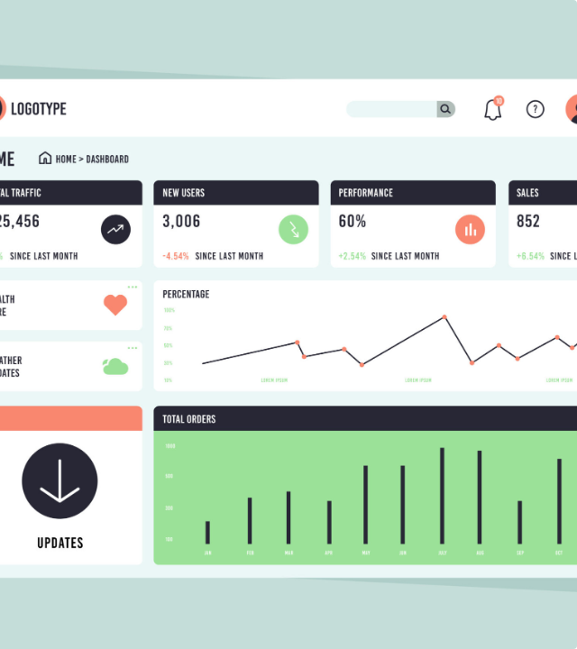
Web Application
Streamlit Deployment
The model was integrated into a live web application using the Streamlit framework. This allows users to:
Enter social media text.
Get instant predictions.
View probability scores.

Slide 16



Collaborative Development
Project Structure
Well-documented scripts for preprocessing, model training, and the final application entry point (app.py).
Version Control
The project was managed via GitHub, enabling seamless code sharing, issue tracking, and collaborative updates between team members.

Slide 17

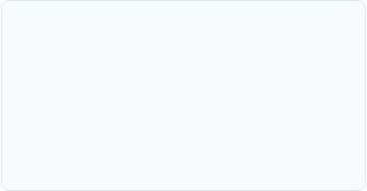
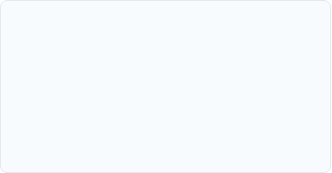
System Advantages
Scalable
Objective
Accessible
Can process thousands of text posts in seconds.
Eliminates human bias in initial status screening.
Available on web browsers for immediate testing.

Slide 18
System Limitations
Sarcasm Detection: NLP struggles with ironic or sarcastic social media context.
Short Text Nuance: Very short posts (2-3 words) may lack sufficient diagnostic features.
Language Scope: Currently optimized primarily for English text.

Slide 19

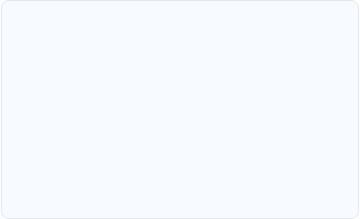
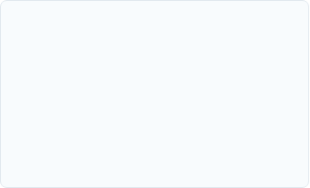
Future Scope
Multi-model
Real-time API
Deep Learning
Incorporating image and video analysis for holistic health checks.
Integration with X/Reddit APIs for proactive health alerts.
Upgrading to Transformer models (BERT/GPT) for higher accuracy.

Slide 20
Thank You
Questions & Answers Session
Team Members: Abhi P Vijay & Nakshathra V

